Slide 1
Fed Up
SS.7.C.1.8 Explain the viewpoints of the Federalists and the Anti-Federalists regarding the ratification of the Constitution and inclusion of a bill of rights.
Debating the Constitution

Slide 2
Bell Ringer
Go to the “Bell Ringer” tab on Teams.
Type your name into the blank space on Microsoft Forms.
Answer the review questions about our last couple of lessons.
Notes:
The link below will provide a 4 minute video from the History Channel: America Gets a Constitution (4 min) TV-PG
After several failed attempts at creating a government, a 1787 convention is called to draft a new legal system for the United States. This new Constitution provides for increased federal authority while still protecting the basic rights of its citizens.
http://www.history.com/topics/shays-rebellion/videos

Slide 3

Constitutional Convention
In 1787, representatives of the states met in Philadelphia at the Constitutional Convention.
They intended to revise (or edit) the Articles of Confederation
Instead, they discarded them and wrote the Constitution of the United States.
Notes:
The link below will provide a 4 minute video from the History Channel: America Gets a Constitution (4 min) TV-PG
After several failed attempts at creating a government, a 1787 convention is called to draft a new legal system for the United States. This new Constitution provides for increased federal authority while still protecting the basic rights of its citizens.
http://www.history.com/topics/shays-rebellion/videos

Slide 4
Constitutional Convention
By abandoning the Articles, the delegation would write a Constitution that:
Created the 3 branches of government
Addressed the issue of states rights
Implemented a system for changing, or amending, the Constitution that did not require a unanimous vote
Protected the rights of the people
Gave power to the federal government to tax, regulate trade, enforce national laws, and more
Notes:
This slide explains what the Constitution would include that was absent in the Articles of Confederation.

Slide 5
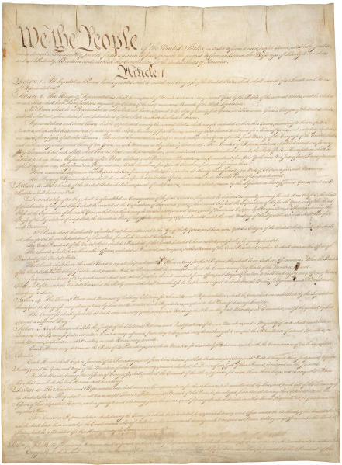
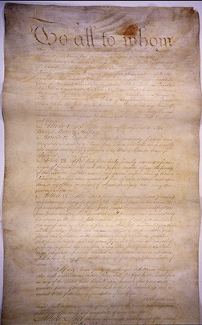
The Road to the Constitution
U.S.
Constitution
No executive branch
No enforcement of laws
No tax
Unanimous vote to make changes
No judicial branch
No regulating trade
Articles of Confederation
Notes:
Review the things that were missing from the Articles that proved to be problematic for the new United States.

Slide 6
The Constitution (as of 1787)
Preamble
Article I – Legislative Branch
Article II – Executive Branch
Article III – Judicial Branch
Article IV – States
Article V – Amendments (how to change the Constitution)
Article VI – Constitution as the Supreme Law of the Land
Article VII – Ratification
What is ratification?
Notes:
The original Constitution only included the Preamble and seven articles. The following slide will define ratification.

Slide 7
Ratification
To ratify means to approve.
9 of the 13 states had to approve the Constitution.
The Federalists and Anti-Federalists debated the Constitution and its lack of a Bill of Rights.
Notes:
Explain the definition of ratification and tell the students that this newly proposed Constitution was controversial. Remember: the convention was only supposed to be about REVISING the Articles of Confederation – not writing an entirely new constitution.

Slide 8
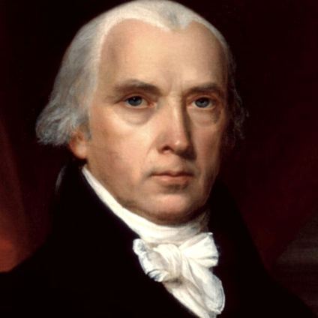
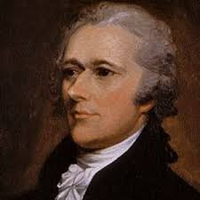
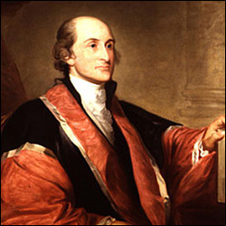
The Federalists
James Madison
Alexander Hamilton
John Jay

Slide 9
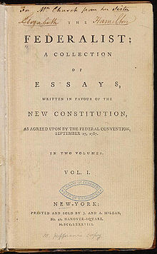
Federalists
The Federalists were the people who supported ratifying the Constitution.
The Federalist Papers
Articles written supporting ratification
One of the most important explanations of constitutional government
Notes:
Explain that the Federalists supported the Constitution and wrote essays in favor of ratification. These essays, known at The Federalist Papers, were some of the most important explanations of constitutional government to date.

Slide 10
What did the Federalists think?
We need to get rid of the Articles of Confederation; too weak and should be replaced;
We need a strong central government;
The Constitution, as it is written, protects the rights of the people.
Principal authors of the Federalist Papers:
James Madison
Alexander Hamilton
John Jay
Notes:
Tell students to take notes on the main thoughts of the Federalists. They believed the Articles were too weak and a new constitution was needed, there was a need for a strong, central government, and the the Constitution, as written, provided for protection of the rights of the people.

Slide 11
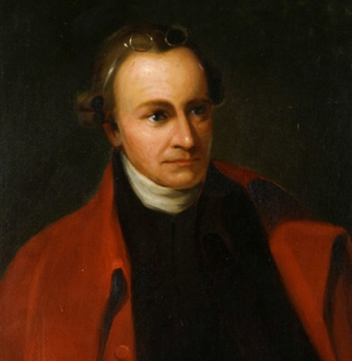
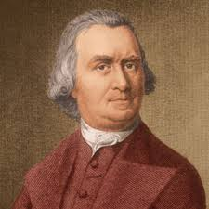
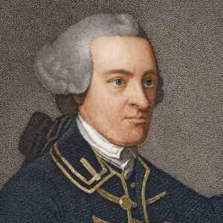
The Anti-Federalists
Patrick Henry
Samuel Adams
John Hancock

Slide 12
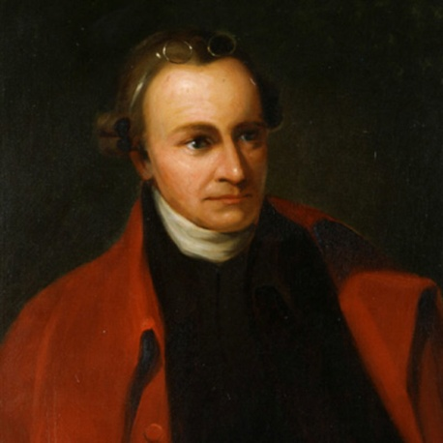
The Anti-Federalists
Opposed to the ratification of the Constitution
Wrote the Anti-Federalist Papers
Warned of the dangers of tyranny not protected by the Constitution
John Hancock
Patrick Henry
Samuel Adams
Notes:
Anti-Federalists were against the ratification of the Constitution. They, like the Federalists, wrote a series of essays, but these were about why the Constitution should NOT be approved. These were called the Anti-Federalist Papers.

Slide 13
What did the Anti-Federalists think?
We should revise and keep the Articles of Confederation
We should divide the power among the state governments
If we are to have the Constitution, the rights of the people should be clearly outlined; wanted to include a “Bill of Rights”
Notes:
The Anti-Federalists had a few main concerns: They believed the Articles just needed to be revised, that the power should remain in state governments, and that if a different constitution is going to happen, it needed to include a clear outline of the rights of the people, called a Bill of Rights.

Slide 14
Difference of Opinion
Anti-Federalists
Federalists
Keep the Articles of Confederation
Favored power divided among state governments
People should be protected from the power of government by having clearly outlined rights in a “Bill of Rights” in the Constitution
Toss the Articles of Confederation
Favored strong central government
Believed the Constitution in its original form would protect the rights of the people
Notes:
Students should copy these distinctions in their notes in a side-by-side comparison.

Slide 15
Who Said It?
The following quotes are from The Federalist Papers and The Anti-Federalist Papers. After reading the quote, determine:
Who would have said it (Federalists or Anti-Federalists)
What they were talking about (state government v. central government, rights of the people)
Notes:
Students will be presented with a series of quotes and will need to determine if the quote is from the Federalist Papers or the Anti-Federalist Papers.

Slide 16
Anti-Federalist – Specifically outlined rights
“The Constitution proposed to your acceptance is designed, not for yourselves alone, but for generations yet unborn. The principles, therefore, upon which the social compact is founded, ought to have been clearly and precisely stated, and the most express and full declaration of rights to have been made. But on this subject there is almost an entire silence.”
Notes:
Anti-Federalist Papers - #84

Slide 17
Anti-Federalist – State governments
“It has been objected too that the new system... is calculated to and will effect such a consolidation of the States, as to supplant and overturn the state governments.”
Notes:
Anti-Federalist Papers - #85

Slide 18
Federalists – federal/central government
The powers delegated by the proposed Constitution to the federal government are few and defined. Those which are to remain in the State governments are numerous and indefinite.
Notes:
Federalist Papers - #45 – James Madison

Slide 19
Federalists – federal/central government
The fabric of American empire ought to rest on the solid basis of THE CONSENT OF THE PEOPLE. The streams of national power ought to flow from that pure, original fountain of all legitimate authority.

Slide 20
Federalists – rights of the people
The truth is, after all the declamations we have heard, that the Constitution is itself, in every rational sense, and to every useful purpose, A BILL OF RIGHTS.
Notes:
The Federalist Papers - #84 – Alexander Hamilton

Slide 21
Anti-Federalist – State governments
“I had rather be a free citizen of the small republic of Massachusetts than an oppressed subject of the great American empire.”
Notes:
Anti-federalist Papers - #1

Slide 22
Key For Remembering
Federalists are for a strong federal (central) government in the Constitution.
Anti-federalists are against a strong federal (central) government and wanted a separate Bill of Rights
As they are opposed to the federal government, that means they are pro-state government and for adding a Bill of Rights to the Constitution

Slide 23

Checking for Understanding
Opposed to a strong national government; pro-state governments
Opposed to a strong national government.
Not a factor in the Federalist/Anti-federalist debate

